Slide 1
SQL Server 2016
New Feature Preview
2016-10-01
@RileyMajor

Slide 2
SQL Saturday #557
Thank you Sponsors!
Please visit the sponsors and enter their end-of-day raffles.
Event After Party
Sky Deck Sports Grille and Lanes at the Mall of America at 7 PM.
Want More Free Training?
PASSMN meets the 3rd Tuesday of every month. https://mnssug.org/

Slide 3
Lunch Sponsor - Dell EMC
For those who paid for lunch already, we will refund you via PayPal. If you wish to donate to Rebecca CoderDojo, please drop your ticket in the bucket at registration.

Slide 4
You Rock Sponsor - Pyramid Analytics
Gold Sponsors
IDERA
Pragmatic Works
VMWare
GNet
Tail Wind
Microsoft
Dell Software

Slide 5

Other Sponsors
Silver Sponsors
Improving
Experts Exchange
Pure Storage
Bronze Sponsors
SQL Sentry
COZYROC
PASS
Blog Sponsors
SQLVariant

Slide 6
SQL Saturday #557
Twitter
@PASSMN
#SQLSatMN

Slide 7
Presentation Overview
Brief History of SQL Server
New Features in 2016
List
Demos
Getting Started with 2016
Future Thoughts
Bio
Notes:
Caveats: I talk mostly about the database engine (as opposed to business intelligence), and from the perspective of a developer at a smaller shop.
Misc links:
http://sqlturbo.com/sql-server-2016-new-features/
http://www.databasejournal.com/features/mssql/slideshows/10-new-features-worth-exploring-in-sql-server-2016.html

Slide 8
SQL Server is Born
1989 - Version 1 (Sybase / Ashton Tate)
1993 - Version 4.2 (Microsoft)
1995 - Version 6
1996 - Version 6.5
1998 - Version 7
Notes:
My first databases were built with dBase IV. I made a database of states and people in my class. I even had a spot for pictures.
I started working with SQL Server version 7 with the Enterprise Manager and Query Analyzer
http://blogs.msdn.com/b/euanga/archive/2006/01/19/sql-mythbusters-sql-server-is-really-a-sybase-product-not-a-microsoft-one.aspx
https://en.wikipedia.org/wiki/Microsoft_SQL_Server
https://en.wikipedia.org/wiki/Ashton-Tate
https://en.wikipedia.org/wiki/Borland
https://en.wikipedia.org/wiki/Sybase

Slide 9
SQL Server Grows Up
2000 - SQL Server 2000
User-Defined Functions, Reporting & Analysis Services
2005 - SQL Server 2005
“completely rewritten”, SSMS, XML, TRY/CATCH, APPLY, CTEs, SSIS, CLR
2008 - SQL Server 2008
Date and Time, Extended Events, Geography, Compression, Filtered Indexes, Resource Governor
2010 - SQL Server 2008 R2
BI Tooling

Slide 10
SQL Server Recent History
SQL Server 2012
TRY_PARSE, LAG/LEAD, Columnstore, Tabular Model
SQL Server 2014
Backup to Azure, Updatable Columnstore, In-Memory OLTP (Hekaton)

Slide 11
The New and Shiny
SQL Server 2016
Available Now
Cumulative Update 2
Free SSMS / Separate Download
Free Developer Version
New T-SQL
New Engine Features
New Admin Features
Notes:
Dan English - What’s new in SQL Server 2016 for Business Intelligence?
http://www.sqlsaturday.com/557/Sessions/Details.aspx?sid=49946
Brian Beswick - SSAS 2016 Tabular - Diving into the new features
http://www.sqlsaturday.com/557/Sessions/Details.aspx?sid=50000
SSMS 2016 Download
https://msdn.microsoft.com/en-us/library/mt238290.aspx
The SQL Server 2016 bits are “free”, but you have to jump through some hoops to get them.
https://blogs.sqlsentry.com/aaronbertrand/get-developer-edition/
SQL Server 2016 CU 1
https://support.microsoft.com/en-us/kb/3164674
SQL Server 2016 CU 2
https://support.microsoft.com/en-us/kb/3182270
SQL Server 2016 Downloads
https://blogs.sqlsentry.com/team-posts/latest-builds-sql-server-2016/

Slide 12
SELECT All the Features
T-SQL Improvements
TRUNCATE TABLE with PARTITION
DROP IF EXISTS
STRING_SPLIT()
DATEDIFF_BIG
AT TIME ZONE
COMPRESS / DECOMPRESS
JSON
Notes:
T-SQL Enhancements
https://www.mssqltips.com/sqlservertip/4108/tsql-enhancements-in-sql-server-2016/
DATEDIFF_BIG
https://msdn.microsoft.com/en-us/library/mt628058.aspx
AT TIME ZONE
https://msdn.microsoft.com/en-us/library/mt612795.aspx
Generating Table of Numbers with JSON
https://blogs.msdn.microsoft.com/sqlserverstorageengine/2015/11/03/generate-serie-of-numbers-in-sql-server-2016-using-openjson/

Slide 13
It slices. It dices.
SELECT STRING_SPLIT(‘a,b,c’,’,’)
Results:
a
b
c
Notes:
Performance Surprises and Assumptions : STRING_SPLIT() by Aaron Betrand
https://sqlperformance.com/2016/03/sql-server-2016/string-split

Slide 14
Squish.
COMPRESS / DECOMPRESS
T-SQL Functions
GZIP Compression
Applied to data (text, binary).
Results in smaller binary data.
Alternative to full table compression.
Standard Edition!
Notes:
COMPRESS / DECOMPRESS in Standard Edition
https://blogs.msdn.microsoft.com/sqlserverstorageengine/2015/12/08/built-in-functions-for-compressiondecompression-in-sql-server-2016/
COMPRESS
https://msdn.microsoft.com/en-us/library/mt622775.aspx
DECOMPRESS
https://msdn.microsoft.com/en-us/library/mt622776.aspx
Whole Table Compression (2012 and onward) - Enterprise Only
https://msdn.microsoft.com/en-us/library/cc280449.aspx

Slide 15
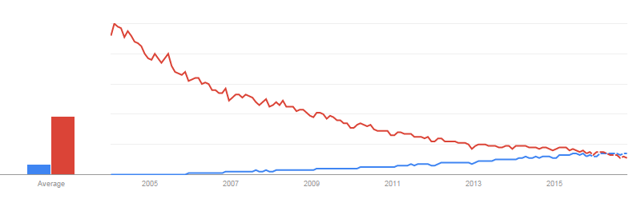
JSON
Why?
What?
XML
JSON
[
{
“MyField1”: “MyValue”,
“MyField2”: 123.45
},
{
“MyField1”: “MyValue2”,
“MyField2”: 345.67
}
]
Notes:
Google Search Trend
https://www.google.com/trends/explore#q=json%2C%20xml&cmpt=q&tz=Etc%2FGMT%2B5
Look at the timing. SQL Server 2005’s XML support came at the apex of XML popularity. SQL Server 2016’s JSON support comes just as JSON surpasses XML.
JSON’s data format is rooted in JavaScript syntax. It’s an array of objects. Each object has properties.
References:
See also Jim Dorame’s Talk: JSON for the DBA
http://www.sqlsaturday.com/557/Sessions/Details.aspx?sid=53668
JSON Data (SQL Server)
https://msdn.microsoft.com/en-us/library/dn921897.aspx
Format Query Results as JSON with FOR JSON (SQL Server)
https://msdn.microsoft.com/en-us/library/dn921882.aspx
SQL Server 2016 : JSON Support
By Aaron Bertrand on May 11, 2015 in T-SQL
http://blogs.sqlsentry.com/aaronbertrand/sql-server-2016-json-support/
How the New JSON Support Will Work in SQL Server 2016
https://visualstudiomagazine.com/blogs/data-driver/2015/05/sql-server-json-support.aspx

Slide 16
JSON vs XML – Sample Data
DECLARE @Orders TABLE
(
OrderID bigint IDENTITY,
OrderDate datetime
);
DECLARE @OrderDetails TABLE
(
OrderDetailsID bigint IDENTITY,
OrderID bigint,
ProductID varchar(50),
Qty int
);
OrderID | OrderDate | ProductID | Qty
1 | 2015-10-10 | Bike | 2
1 | 2015-10-10 | Helmet | 2
1 | 2015-10-10 | Wheels | 4
2 | 2015-10-09 | Ball | 10
Notes:
DECLARE @Orders TABLE
(
OrderID bigint IDENTITY,
OrderDate datetime
);
DECLARE @OrderDetails TABLE
(
OrderDetailsID bigint IDENTITY,
OrderID bigint,
ProductID varchar(50),
Qty int
);
INSERT INTO @Orders
(
OrderDate
)
VALUES
('2015-10-10'),
('2015-10-09');
INSERT INTO @OrderDetails
(
OrderID,
ProductID,
Qty
)
VALUES
(1,'Bike',2),
(1,'Helmet',2),
(1,'Wheels',4),
(2,'Ball',10);
SELECT
Orders.OrderID,
Orders.OrderDate,
OrderDetails.ProductID,
OrderDetails.Qty
FROM @Orders AS Orders
JOIN @OrderDetails AS OrderDetails
ON Orders.OrderID = OrderDetails.OrderID;
SELECT 'Path (Default)';
SELECT
Orders.OrderID,
Orders.OrderDate,
OrderDetails.ProductID,
OrderDetails.Qty
FROM @Orders AS Orders
JOIN @OrderDetails AS OrderDetails
ON Orders.OrderID = OrderDetails.OrderID
FOR XML PATH;
SELECT
Orders.OrderID,
Orders.OrderDate,
OrderDetails.ProductID,
OrderDetails.Qty
FROM @Orders AS Orders
JOIN @OrderDetails AS OrderDetails
ON Orders.OrderID = OrderDetails.OrderID
FOR JSON PATH;
SELECT 'Full Auto';
SELECT
Orders.OrderID,
Orders.OrderDate,
OrderDetails.ProductID,
OrderDetails.Qty
FROM @Orders AS Orders
JOIN @OrderDetails AS OrderDetails
ON Orders.OrderID = OrderDetails.OrderID
FOR XML AUTO;
SELECT
Orders.OrderID,
Orders.OrderDate,
OrderDetails.ProductID,
OrderDetails.Qty
FROM @Orders AS Orders
JOIN @OrderDetails AS OrderDetails
ON Orders.OrderID = OrderDetails.OrderID
FOR JSON AUTO;
SELECT 'Path (Custom)';
SELECT
Orders.OrderID,
Orders.OrderDate,
(
SELECT
OrderDetails.ProductID,
OrderDetails.Qty
FROM @OrderDetails AS OrderDetails
WHERE Orders.OrderID = OrderDetails.OrderID
FOR XML PATH('OrderDetail'), TYPE
) AS OrderDetails
FROM @Orders Orders
FOR XML PATH('Order'), ROOT('Orders');
SELECT
Orders.OrderID,
Orders.OrderDate,
(
SELECT
OrderDetails.ProductID,
OrderDetails.Qty
FROM @OrderDetails AS OrderDetails
WHERE Orders.OrderID = OrderDetails.OrderID
FOR JSON PATH
) AS OrderDetails
FROM @Orders Orders
FOR JSON PATH, ROOT('Orders');

Slide 17
JSON vs XML – Production (Path)
JSON
XML
SELECT
Orders.OrderID,
Orders.OrderDate,
OrderDetails.ProductID,
OrderDetails.Qty
FROM @Orders AS
Orders
JOIN @OrderDetails AS OrderDetails
ON Orders.OrderID = OrderDetails.OrderID
FOR JSON
PATH;
SELECT
Orders.OrderID,
Orders.OrderDate,
OrderDetails.ProductID,
OrderDetails.Qty
FROM @Orders AS
Orders
JOIN @OrderDetails AS OrderDetails
ON Orders.OrderID = OrderDetails.OrderID
FOR XML
PATH;

Slide 18
JSON vs XML – Production (Path)
JSON
XML
[
{
"OrderID":1,
"OrderDate":"2015-10-10T00:00:00",
"ProductID":"Bike",
"Qty":2
},
{
"OrderID":1,
"OrderDate":"2015-10-10T00:00:00",
"ProductID":"Helmet",
"Qty":2
},
{
"OrderID":1,
"OrderDate":"2015-10-10T00:00:00",
"ProductID":"Wheels",
"Qty":4
},
{
"OrderID":2,
"OrderDate":"2015-10-09T00:00:00",
"ProductID":"Ball",
"Qty":10
}
]
<row>
<OrderID>1</OrderID>
<OrderDate>2015-10-10T00:00:00</OrderDate>
<ProductID>Bike</ProductID>
<Qty>2</Qty>
</row>
<row>
<OrderID>1</OrderID>
<OrderDate>2015-10-10T00:00:00</OrderDate>
<ProductID>Helmet</ProductID>
<Qty>2</Qty>
</row>
<row>
<OrderID>1</OrderID>
<OrderDate>2015-10-10T00:00:00</OrderDate>
<ProductID>Wheels</ProductID>
<Qty>4</Qty>
</row>
<row>
<OrderID>2</OrderID>
<OrderDate>2015-10-09T00:00:00</OrderDate>
<ProductID>Ball</ProductID>
<Qty>10</Qty>
</row>
Notes:
Formatters:
JSON
https://jsonformatter.curiousconcept.com/
XML
http://www.freeformatter.com/xml-formatter.html#ad-output

Slide 19
JSON vs XML – Production (Auto)
JSON
XML
SELECT
Orders.OrderID,
Orders.OrderDate,
OrderDetails.ProductID,
OrderDetails.Qty
FROM @Orders AS
Orders
JOIN @OrderDetails AS OrderDetails
ON Orders.OrderID = OrderDetails.OrderID
FOR JSON
AUTO;
SELECT
Orders.OrderID,
Orders.OrderDate,
OrderDetails.ProductID,
OrderDetails.Qty
FROM @Orders AS
Orders
JOIN @OrderDetails AS OrderDetails
ON Orders.OrderID = OrderDetails.OrderID
FOR XML
AUTO;

Slide 20
JSON vs XML – Production (Auto)
JSON
XML
[
{
"OrderID":1,
"OrderDate":"2015-10-10T00:00:00",
"OrderDetails":
[
{ "ProductID":"Bike", "Qty":2 },
{ "ProductID":"Helmet", "Qty":2 },
{ "ProductID":"Wheels", "Qty":4 }
]
},
{
"OrderID":2,
"OrderDate":"2015-10-09T00:00:00",
"OrderDetails":
[
{ "ProductID":"Ball", "Qty":10 }
]
}
]
<Orders OrderID="1" OrderDate="2015-10-10T00:00:00">
<OrderDetails ProductID="Bike" Qty="2" />
<OrderDetails ProductID="Helmet" Qty="2" />
<OrderDetails ProductID="Wheels" Qty="4" />
</Orders>
<Orders OrderID="2" OrderDate="2015-10-09T00:00:00">
<OrderDetails ProductID="Ball" Qty="10" />
</Orders>

Slide 21
JSON vs XML – Path with Nesting
JSON
XML
SELECT
Orders.OrderID,
Orders.OrderDate,
(
SELECT
OrderDetails.ProductID,
OrderDetails.Qty
FROM @OrderDetails AS OrderDetails
WHERE Orders.OrderID = OrderDetails.OrderID
FOR JSON PATH
) AS OrderDetails
FROM @Orders Orders
FOR JSON PATH,
ROOT('Orders');
SELECT
Orders.OrderID,
Orders.OrderDate,
(
SELECT
OrderDetails.ProductID,
OrderDetails.Qty
FROM @OrderDetails AS OrderDetails
WHERE Orders.OrderID = OrderDetails.OrderID
FOR XML PATH('OrderDetail'), TYPE
) AS OrderDetails
FROM @Orders Orders
FOR XML PATH('Order'), ROOT('Orders');

Slide 22
JSON vs XML – Path with Nesting
JSON
XML
{
"Orders":
[
{
"OrderID":1,
"OrderDate":"2015-10-10T00:00:00",
"OrderDetails":
[
{"ProductID":"Bike","Qty":2},
{"ProductID":"Helmet","Qty":2},
{"ProductID":"Wheels","Qty":4}
]
},
…
]
}
<Orders>
<Order>
<OrderID>1</OrderID>
<OrderDate>2015-10-10T00:00:00</OrderDate>
<OrderDetails>
<OrderDetail>
<ProductID>Bike</ProductID>
<Qty>2</Qty>
</OrderDetail>
<OrderDetail>
<ProductID>Helmet</ProductID>
<Qty>2</Qty>
</OrderDetail>
<OrderDetail>
<ProductID>Wheels</ProductID>
<Qty>4</Qty>
</OrderDetail>
</OrderDetails>
</Order>
…
</Orders>

Slide 23
Unholy Unions
XML in JSON
JSON in XML
{
"UnholyUnion":
"<DataList DataElement=\"Yes, you can put XML in JSON!\"\/><DataList DataElement=\"But why would you do this?\"\/>"
}
<row>
<UnholyUnion>
[{"DataElement":"Yes, you can put JSON in XML!"},{"DataElement":"But why would you do this?"}]
</UnholyUnion>
</row>
Notes:
SELECT
(
SELECT *
FROM (VALUES
('Yes, you can put XML in JSON!'),
('But why would you do this?')) AS DataList(DataElement)
FOR XML AUTO
) AS UnholyUnion
FOR JSON PATH;
SELECT
(
SELECT *
FROM (VALUES
('Yes, you can put JSON in XML!'),
('But why would you do this?')) AS DataList(DataElement)
FOR JSON AUTO
) AS UnholyUnion
FOR XML PATH;

Slide 24
Look ma, no tags!
XML
JSON
SELECT
'Test'
FOR XML PATH('');
Results:
Test
SELECT
'Test'
FOR JSON PATH;
Results:
Msg 13605, Level 16, State 1, Line 1
Unnamed tables cannot be used as JSON identifiers as well as unnamed columns cannot be used as key names. Add alias to the unnamed column/table.

Slide 25
You’re just not my type.
XML is a data type.
JSON is *not* a data type. Use NVARCHAR.
Already being stored as text.
But so was XML.
And so what? Convert over time. Convert on the fly.
Don’t have to update other SQL Server tools.
Boo hoo. Ok for now, but convert over time.
Client apps can handle native XML but not JSON.
Wait, what?
And so what if it’s text to the outside world; what about in-database performance?
Notes:
JSON Support in SQL Server 2016 - Jovan Popovic (MSFT) 16 May 2015 7:17 AM
http://blogs.msdn.com/b/jocapc/archive/2015/05/16/json-support-in-sql-server-2016.aspx
MSSQL Server 2016 coming with JSON support (not really)
http://www.itworld.com/article/2925117/enterprise-software/mssql-server-2016-coming-with-json-support-not-really.html

Slide 26
Nettlesome Nesting
XML
JSON
SELECT
CONVERT(xml,
'<TextXML>I typed this.</TextXML>'
) AS 'OuterTag'
FOR XML PATH('');
Results:
<OuterTag>
<TextXML>I typed this.</TextXML>
</OuterTag>
SELECT
'{"TextJSON":"I typed this."}' AS 'OuterTag'
FOR JSON PATH;
Results:
{"OuterTag":"{\"TextJSON\":\"I typed this.\"}"}

Slide 27
Nettlesome Nesting - Workaround
SELECT
(
SELECT
'I typed this.' AS TextJSON
FOR JSON PATH
) AS 'OuterTag'
FOR JSON PATH;
Results:
{"OuterTag":{"TextJSON":"I typed this."}}

Slide 28
Well is it or isn’t it?
Without JSON type, can’t use TRY_CONVERT() to validate.
Use ISJSON() instead.
Can use in CHECK constraint to ensure text field has valid JSON.
Can then safely create calculated field based off JSON contents.

Slide 29
Is it “rows” or “records”?
OPENXML
Nodes
DECLARE
@i int,
@x xml = '<x><a>1</a><a>2</a></x>';
EXEC sp_xml_preparedocument @i OUTPUT, @x;
SELECT * FROM
OPENXML (@i, '/x/a', 2)
WITH (a varchar(10) '.');
DECLARE
@x xml = '<x><a>1</a><a>2</a></x>';
SELECT a.value('.','varchar(10)')
FROM @x.nodes('/x/a') AS x(a);

Slide 30
But I haven’t prepared!
There is no nodes-style syntax for JSON.
OPENJSON has similar syntax to OPENXML.
No prepare statement is needed.
Work in user-defined function?
Multiple in single SQL statement?
Performance?

Slide 31
OPENJSON
DECLARE @j nvarchar(max) = '{"Orders": [
{"OrderID":1, "OrderDate": "2015-10-10"},
{"OrderID":2, "OrderDate": "2015-10-09"}]}';
SELECT
OrderID, OrderDate
FROM OPENJSON (@j, '$.Orders')
WITH
(
OrderID bigint,
OrderDate datetime
) AS OrdersArray;

Slide 32
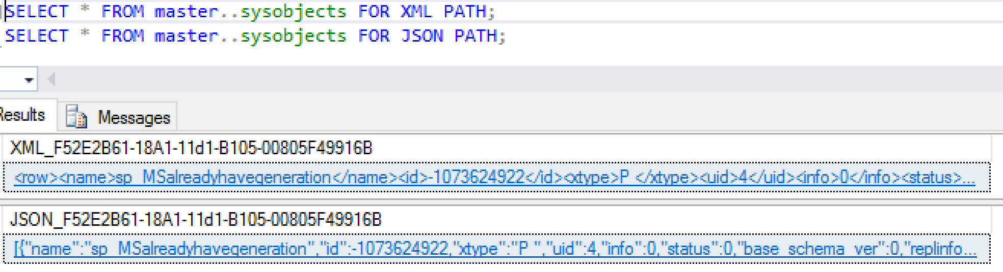
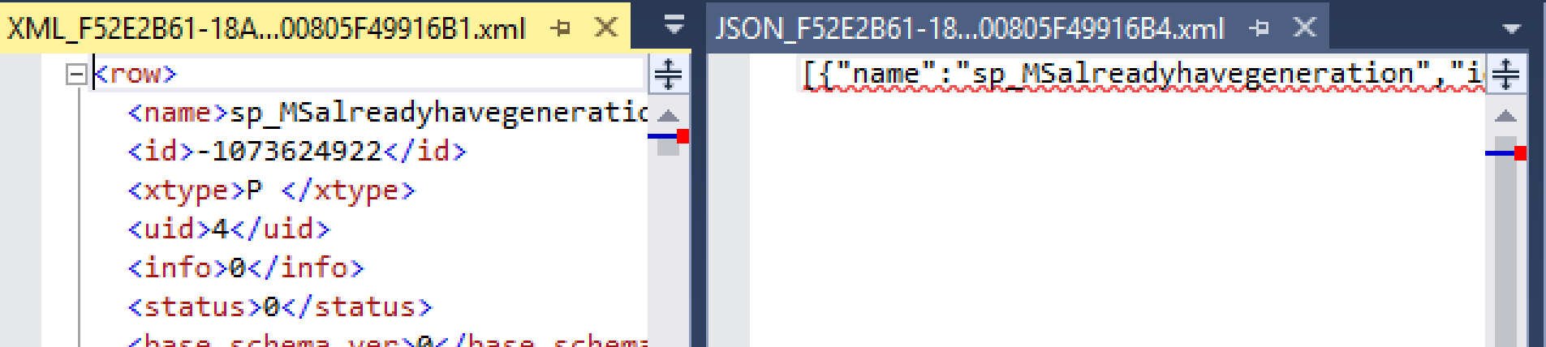
Jason who?
SSMS sees JSON as special but doesn’t deliver.

Slide 33
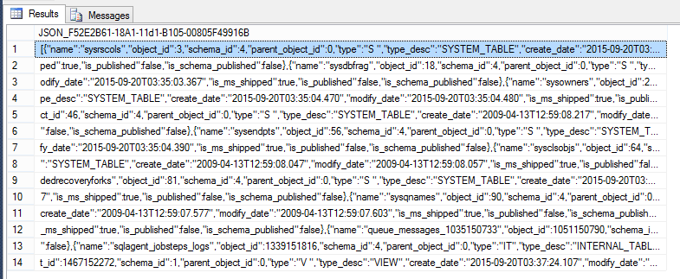
Yuck.
| Riley Major | SQL Server 2016 – New Feature Preview
2015-10-10

Slide 34
JSON Summary
FOR JSON
Works pretty much like FOR XML.
OPENJSON
Similar to OPENXML, but no need for separate “preparation” step (sp_xml_preparedocument).
ISJSON(@JSON)
Similar to TRY_CONVERT(xml, '<x>xml</x>')
JSON_VALUE(@JSON, '$.Order.Qty')
Similar to @XML.value
| Riley Major | SQL Server 2016 – New Feature Preview
2015-10-10

Slide 35
Vroom, vroom!
Engine Improvements
Temporal Tables
Query Store
Dynamic Data Masking
Live Query Statistics
In-Memory OLTP Improvements
R
Notes:
Dynamic Data Masking
https://msdn.microsoft.com/en-us/library/mt130841.aspx

Slide 36
Flux Capacitor
Temporal Tables
Like Apple’s Time Machine, but for your tables.
Can operate entirely transparently to existing applications.
Main table gets two extra time stamp fields.
History table:
Has same schema and stores old information.
Uses compression by default.
Can be queried directly.
Microsoft suggests using Azure stretch table.

Slide 37
Temporal Tables – Basic Syntax
CREATE TABLE OrderDetails
(
OrderDetailID bigint IDENTITY PRIMARY KEY,
OrderID bigint,
ProductID varchar(50),
Qty int,
EffectiveStart datetime2
GENERATED ALWAYS AS ROW START NOT NULL,
EffectiveStop datetime2
GENERATED ALWAYS AS ROW END NOT NULL,
PERIOD FOR SYSTEM_TIME (EffectiveStart, EffectiveStop)
)
WITH (SYSTEM_VERSIONING =
ON (HISTORY_TABLE = dbo.OrderDetailsHistory));
Notes:
Temporal Tables
https://msdn.microsoft.com/en-us/library/dn935015.aspx
CREATE TABLE (Transact-SQL)
https://msdn.microsoft.com/en-us/library/ms174979.aspx

Slide 38
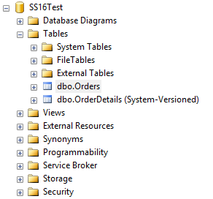
Temporal Tables – Time Travelling
SELECT *
FROM OrderDetails
FOR
SYSTEM_TIME
AS OF @dt
ORDER BY OrderDetailID;

Slide 39
Cha-ching!
Query Store
Store ALL the query plans!
Your plan cache is only so big, but your disks are bigger.
Why recompile when you can reload?
Reboot? Would you like me to warm that cache up for you?
Don’t like this new plan? Return it for a full refund!

Slide 40
<REDACTED>
Dynamic Data Masking
Hides sensitive information (such as personally-identifiable information– PII) from normal users.
There are a variety of masking functions which turn text into XXXX, dates into 1900-01-01, etc.
UNMASK permissions are required to see real data.
Notes:
Dynamic Data Masking
https://msdn.microsoft.com/en-us/library/mt130841.aspx

Slide 41
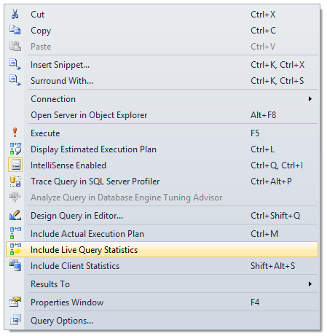
Live Query Statistics
Boom!
Wow.
“The performance impact of turning this on, on a production server, could be significant.” – Russ Thomas
☹
Notes:
You have to enable this in advance. You can’t just start monitoring an existing long-running query.
Coming Soon SQL 2016 Live Query Statistics (LQS)
https://sqljudo.wordpress.com/2015/06/02/coming-soon-sql-2016-live-query-statistics-lqs/
Live Query Statistics
https://msdn.microsoft.com/en-us/library/dn831878.aspx

Slide 42
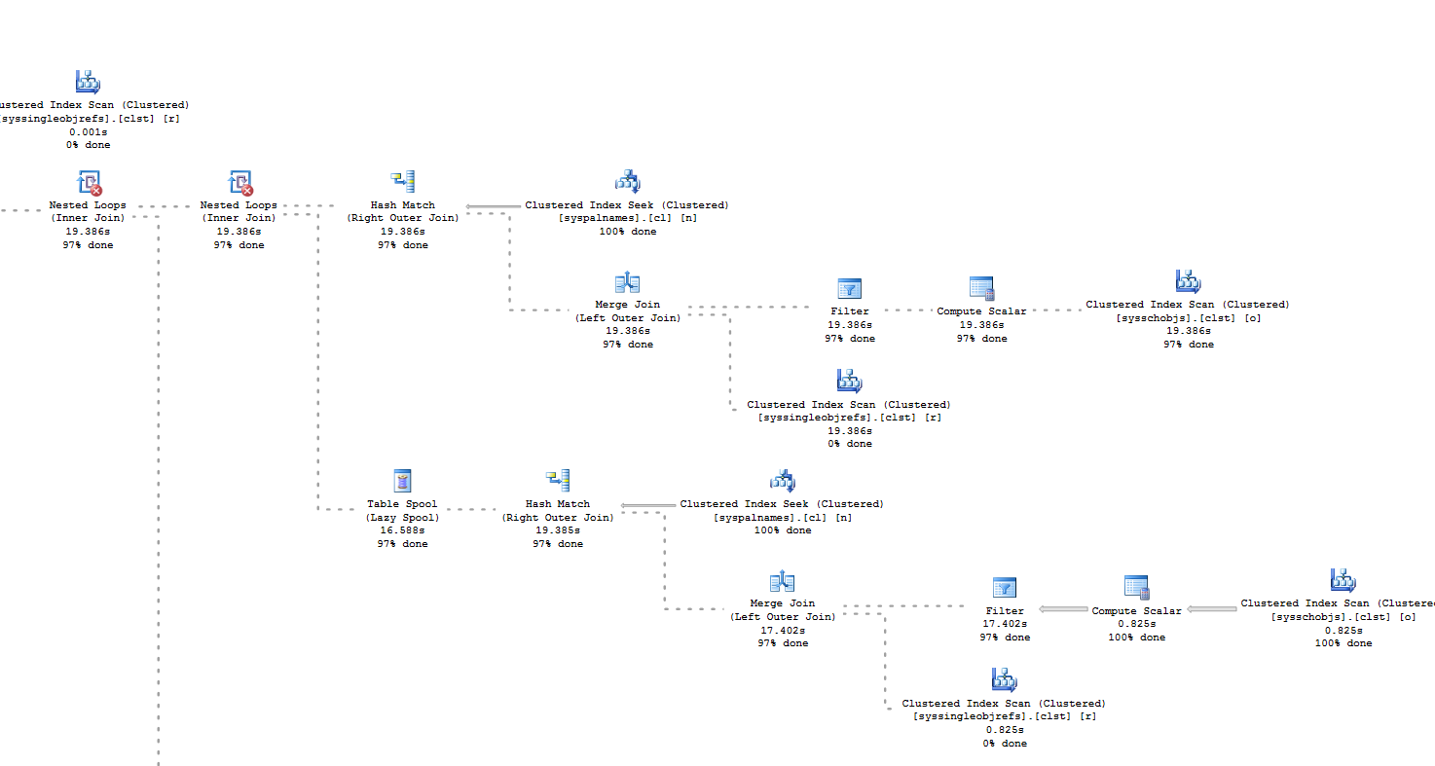
Feast your eyes…
Notes:
Coming Soon SQL 2016 Live Query Statistics (LQS)
https://sqljudo.wordpress.com/2015/06/02/coming-soon-sql-2016-live-query-statistics-lqs/

Slide 43
But wait, there’s more…
Administrative Features
Always Encrypted
Stretch Database (Auto-Archive to Azure)
Row-Level Security
Multiple Secondary Readers for Load Balancing
Automatic TempDB Optimization
Polybase (T-SQL for Hadoop)
Notes:
Row-Level Security
http://www.databasejournal.com/features/mssql/row-level-security-with-sql-server-2016.html

Slide 44
Hold this but don’t look inside.
Always Encrypted
Defined for Specific Columns
DBA Can’t See the Data
Useful for Hosting Environments
Keys Stored on Client or in Key Store
Encrypted/Decrypted by Drivers
No Special App Coding
Choose Repeatable Encryption for Increased Speed but Decreased Security
Enterprise Only
Notes:
See also Ed Leighton-Dick’s

Slide 45
To infinity, and beyond!
Stretch Database
Configured on individual tables.
Define criteria for “cold” data.
SQL Server manages migration of data.
SQL Server seamlessly merges cold and hot data.
Can use full Azure SQL Database instance or special stretch database instance with unlimited storage.
Local backups don’t include remotely stored data.
Notes:
SQL Server Stretch Database
https://azure.microsoft.com/en-us/services/sql-server-stretch-database/
MSDN Stretch Database
https://msdn.microsoft.com/en-us/library/dn935011.aspx
Paul Timmerman Talk
http://www.sqlsaturday.com/557/Sessions/Details.aspx?sid=53602

Slide 46
Kinda Sorta
You can approximate many features in previous versions with a lot of effort.
Data Masking, Row-Level Security -> Views
STRING_SPLIT() -> Variety of Methods
TRUNCATE PARTITION -> Re-create
Stretch Database -> Jobs, Linked Servers, & Views
DROP IF EXISTS -> Extra IF
Temporal Tables -> Triggers & Views

Slide 47
Pay to Play
Standard vs Enterprise
Most new features available in Standard.
Enterprise:
Polybase
Always Encrypted
Multiple Secondary Readers

Slide 48
Hey, hey, hey… goodbye!
SQL Server 2016 didn’t discontinue any features.
Can no longer act as SQL Server 2005.
Can’t use MD5 / SHA1 in current compatibility mode.
Notes:
Discontinued Features in 2016
https://msdn.microsoft.com/en-US/library/ms144262.aspx

Slide 49
Still Kicking
Killed in Next Version:
SET ROWCOUNT for Modification
(Use TOP Instead)
Result sets from triggers.
Remote Servers
(Use Linked Servers Instead)
Killed Eventually:
Omitting Semicolons
Database Mirroring
Notes:
Deprecated Database Engine Features in SQL Server 2016
https://msdn.microsoft.com/en-us/library/ms143729.aspx

Slide 50
The People Have Spoken
JSON Support is #1 Connect Item
1070 Up-Votes
But…
CREATE OR REPLACE
7th Most Popular (442 Up-Votes)
Created in March of 2005
Notes:
Add native support for JSON to SQL Server, a la XML (as in, FOR JSON or FROM OPENJSON) By - bret_m_lowery
https://connect.microsoft.com/SQLServer/Feedback/Details/673824

Slide 51
In the year 2000…
SQL Server 2018?
Brent Ozar: VMs mean 2005 & 2008 4eva
Other popular Connect items:
Better Error Info for “String… truncated”
Error Table for Big Insert/Update Failures
Inline Scalar UDFs
Full Regex for LIKE, etc.
Built-in Tally Table (Table of Numbers)
Read/Write Table-Valued Parameters
Notes:
Most of the popular Connect items are T-SQL or developer-centric improvements but they haven’t been getting a lot of love recently. It’s all about Big Data and big speed.
Databases Five Years from Today
http://www.brentozar.com/archive/2013/03/databases-five-years-from-today/
Connect items:
Please fix the "String or binary data would be truncated" message to give the column name By – Dwalker
https://connect.microsoft.com/SQLServer/Feedback/Details/339410
new virtual table: errors. It would analogous to the deleted and inserted tables By - danholmes
https://connect.microsoft.com/SQLServer/Feedback/Details/774754
The Scalar Expression function would speed performance while keeping the benefits of functions. - by Andrew Novick
https://connect.microsoft.com/SQLServer/Feedback/Details/273443
Regex functionality in pattern matching By - Simon Sabin
https://connect.microsoft.com/SQLServer/Feedback/Details/261342
Add a built-in table of numbers By - Erland Sommarskog
https://connect.microsoft.com/SQLServer/Feedback/Details/258733
Relax restriction that table parameters must be readonly when SPs call each other. By - Erland Sommarskog
https://connect.microsoft.com/SQLServer/Feedback/Details/299296

Slide 52
Shut Up and Take My Money
“While this has also been hotly requested, I’d caution you to be careful what you ask for. Users demanded XML support inside SQL Server, and then proceeded to use SQL Server as an XML query engine, sending CPU through the roof. SQL Server is one of the world’s most expensive application servers.”
– Brent Ozar, 2015-05-04
Notes:
Reading the SQL Server 2016 Data Sheet
http://www.brentozar.com/archive/2015/05/reading-the-sql-server-2016-data-sheet/

Slide 53
Download Now
SQL Server 2016 Developer Version
SQL Server Management Studio 2016
They are *free*.
You can install as a separate instance and application.
Play with Azure SQL Database.

Slide 54
Evaluations
Please fill them out.
In person and online.
Sessions and event.
We can’t improve without your feedback.

Slide 55
Riley Major
@RileyMajor | PASSMN@RileyMajor.com
Scribnasium.com
Enterprise Architect
Manna Freight Systems, Inc.
Worked with SQL Server since May of 2000
PASSMN Board – Director of Technology
Conference speaker
Father of three girls

